Slide 1
CDL Licensing Update
Ivy Anderson
Director of Collections
California Digital Library
SLASIAC Meeting
February 25, 2013

Slide 2
Topics I’ll Cover
Context
Budget challenges
Metrics-based approach to journal evaluation and negotiation
Licensing update
Journals
Ebooks

Slide 3
Budget Challenges

Slide 4
UC Library materials budgets have essentially been flat for nearly a decade

Slide 5
This mirrors a structural problem that exists throughout academia
In the last twenty-seven years, library funding as a percentage of overall university expenditures has declined from nearly 4% to just under 2% -- a drop of 50%

Slide 6
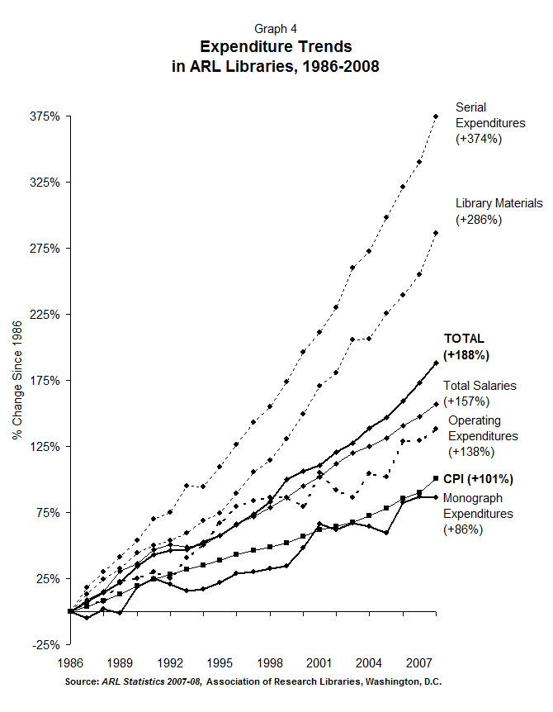
At the same time, journal expenditures have continued to far outpace library budgets, defying marketplace logic.
Why?

Slide 7
The growth of active, peer reviewed learned journals since 1665
The problem of cost control for journals is due in part to the steady increase in research publication over time, which has averaged 3%+ per year over very long timeframes
(Mabe, 2003)

Slide 8
…which, in turn, is correlated with the growth in numbers of researchers
(Mabe 2004, based on data from ISI and NSF)

Slide 9
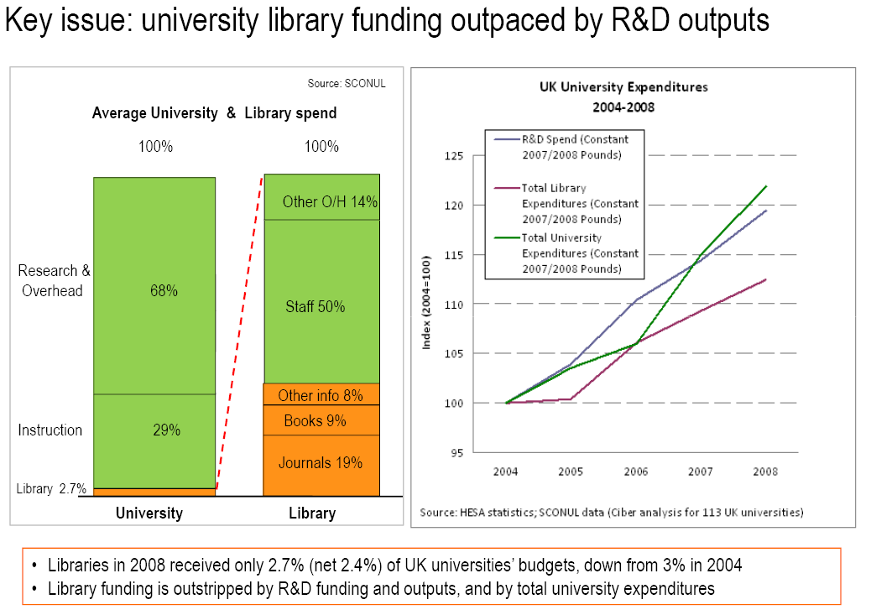
Bergstrom: Hell’s Grocery
Aspesi: A Shift of Power
Big Deals reinforce publisher
monopolies
Strategy: license more selectively,
bargain hard, or walk away
Library budget crises and usage-driven
value assessment will undermine big deals
This will adversely affect the fortunes (and
profits) of large commercial publishers

Slide 10
UC Licensing Strategies

Slide 11
Where UC excels
Power of ten: UC’s reputation and market power deployed to advantage
Negotiating prowess: Consistently superior outcomes
Analytical rigor: Multi-factored value analyses inform negotiating goals and positions
Faculty engagement: Work regularly with UCOLASC
Transformative reach: Pursuit of novel arrangements that foster change

Slide 12
Examples of UC’s licensing effectiveness
Elsevier:
10% savings over 5 years compared with extension of previous contract, with 39% more journal content
Total negotiated savings and cost avoidance: $6-7M
UCSB economist Ted Bergstrom’s analysis of Elsevier big deals found that UC had the best price among its peers
Unit cost per journal for systemwide (10-campus) access: $4,784
Cost per use: $1.01 (less than our cost per use for UC Press journals)
Nature Publishing Group:
UC successfully beat back an attempt by NPG to quadruple UC’s pricing for NPG journals
It’s currently recognized that UC has the best pricing of any institution
Price per use for Nature: $.02
Anne Kenney, Cornell, in CHE: "it was pretty shocking to me that they were getting such a great deal.“
The saga isn’t over – we’re still in discussions

Slide 13
Examples of UC’s licensing effectiveness
Other major journal publishers
CDL journal licenses typically have a ‘multiplier’ of 2.5 - 4 (i.e. UC pays for 2-4 copies, not 10 copies), with access to all journals available at all campuses
0% price caps over multiple years with many publishers
Result:
Springer license: UC subscription fees are now 65% below list price
Purchasing these journals at all campuses at list price would exceed the total collections budget of all ten UC campuses
2006 Wiley analysis showed that access to Wiley journals would plunge by 75%-95% at each campus if our consortial license were cancelled
15% negotiated reduction in base license fee with one journal publisher during the height of the budget crisis (similar reductions with other publishers via cancellation)
Compared to local campus licensing
One campus library has reported paying an average of $342 per title for non-CDL journal subscriptions that it licenses on its own, whereas that same campus’s average cost per CDL-licensed journal title is $69. By this measure, every $1.00 spent on shared journal collections produces $4.00 in savings for the campus.

Slide 14
Transformative Reach
UC-Springer Open Access pilot 2008-2010 – only such arrangement in the U.S. (discontinued by publisher)
Nature Publishing Group – ongoing joint discussions have influenced NPG’s approach to open access
UC-wide open access discount agreements with PLoS and other OA publishers
New: UC Libraries open access fund pilots at each campus provide direct support for faculty OA publishing
Seed funding provided by CDL
CDL model license – a gold standard adopted by many other institutions
New: Author rights clause negotiated in CDL licensing agreements

Slide 15
Successes in 2010-2012
15% reductions ($2 million) achieved in base cost for selected major products
0% increases for nearly 90 resources
Most others @ 3% or less (with some exceptions)

Slide 16
But, we have to do more…

Slide 17
CDL licensing efficiencies vs. library budget challenges

Slide 18
Major Negotiations in 2012
ACS Web Editions
CRC Press journals, CRCnetbases (Taylor & Francis)
Karger journals
Lippincott, Williams & Wilkins journals
Springer journals and ebooks
Taylor & Francis journals
Thomson ISI – Web of Science, Biosis, INSPEC
Wiley journals and ebooks

Slide 19
Prior to Major Negotiations: Journal Evaluation Project
http://www.cdlib.org/services/collections/protected/journalevaluation/index.html
13

Slide 21
Intended Outcomes
Improve our ability to make consortial decisions across the entire collection of collaboratively-licensed journals
Simplify the process for evaluating and managing journal titles
Prepare for multi-year contracts on a longer time horizon to better anticipate and plan for negotiation challenges and desired outcomes
Develop a shared knowledge base for consortial licensing goals, including treatment of niche titles, and relationship between local and systemwide licensing
Develop agreed-upon strategies for licensing titles outside of systemwide packages
Explore the potential for utilizing the title level data to arrive at a better value-based price for journal packages

Slide 22
Approach: Holistic Review of CDL-Licensed Journals using CDL Weighted Value Algorithm
How much value does UC derive from each journal that we license systemwide compared to other journals in the same discipline?
Key Features:
Analyzed all 8,000 CDL-licensed journals according to 3 vectors of value
Utility
Quality
Cost-Effectiveness
Accounts for disciplinary differences through subject-specific benchmarks
Numerical score with simple value designations
High, medium, low, ‘lowest’
Measurement Category | Total Score | Metrics
Utility | 0-3 | UC usage
 |  | UC citations
Quality | 0-2 | SNIP
 |  | Impact Factor
Cost Effectiveness | 0-2 | Cost per Use
 |  | Cost per SNIP
Journals are compared across more than 160 subjects

Slide 23
Disciplinary differences matter

Slide 26
Higher Value Publishers

Slide 27
Lower Value Publishers

Slide 28
T&F Usage Comparison in Largest 29 Subjects Covering two thirds of T&F Titles

Slide 29
T&F Cost Per Use Comparison in Largest 29 Subjects Covering two thirds of T&F Titles

Slide 30
Goals for our T&F and Karger Contracts
CDL Goal: Try to preserve these agreements with a reduced spend that adjusts cost to value
T&F is a major publisher, with a strong list in some disciplines, but its pricing is not competitive for the level of use and impact its journals attract
Karger is a small, privately-held specialty biomedical publisher with quality journals in several areas – contributes to diversity in the marketplace
T&F Status
Awaiting final proposal
Fallback 1: Scale back to a much smaller package combined with local subscriptions
Fallback 2: Cancel the systemwide license, revert to campus-only subscriptions
Campuses have carefully reviewed T&F journals to determine which titles to retain locally if we walk away
Karger Status
Publisher has agreed to a price reduction

Slide 31
eBooks
Springer complete collection, 2012
Wiley online library, 2012
SIAM e-library, all series (400 titles)
Royal Society of Chemistry ebooks (1968-2012)

Slide 32
More ebook offerings under consideration
ARL collaborative licensing initiative
Attempting to establish standards and appropriate pricing for university press ebook licensing
CDL sits on ARL’s advisory committee
New university press offerings under consideration
Project Muse University Press Consortium
Harvard University Press (via De Gruyter)
Books@JSTOR
Oxford University Press Scholarship Online
Other
CRC Press
Open access ebooks??
Knowledge Unlatched -- A new initiative by the former head of Bloomsbury Press to foster library investment in open access monographs from university presses

Slide 33
eBooks present many new issues
Packages vs. selective (‘demand-driven’) approaches?
Packages are cost-effective on a per-title basis but have the same weaknesses as journal big deals – large fixed expenditures with annual increases as publisher output grows
Inclusion of course-adoption titles?
Integration with approval vendors and plans?
Access on mobile devices?
ILL rights vs. paid short-term loan?
Relationship to print, print-on-demand?
If users continue to want print, will this require a duplicative expenditure?

Slide 35
Typical user comment
“I answered that I prefer print books, generally. However, the better answer would be that print books are better in some situations, while e-books are better in others. Each have their role – e-books are great for assessing the book, relatively quick searches, like encyclopedias or fact checking, checking bibliography for citations, and reading selected chapters or the introduction. If I want to read the entire book, I prefer print. If I want to interact extensively with the text, I would buy the book to mark up with my annotations; if I want to read for background (not as intensively) I will check out a print book from the library if possible. All options have their place. I am in humanities/social sciences, so print is still very much a part of my research life at this point.” (Graduate Student, Humanities, Social Sciences)

Slide 36
Complementarity
“I use e-books primarily to determine if the content is going to be helpful to me – table of contents, index, or perhaps skimming a chapter or two. I dislike reading on a screen, and so if I conclude that I want to read the book, I borrow it through our library or ILL.” (Faculty, Arts & Humanities)
“E-books are a convenience to see if I need that book. Once I have figured out that I do indeed need the book, I either go purchase it or borrow it from the library.” (Undergraduate, Life & Health Sciences)
“I find that e-books are most useful when I need to find a bit of text quickly for a citation or to check whether or not a book will be useful to my work. E-books save me a trip to the library in these cases. But, I rarely read books online. The interface is clunky, my Internet is slow, and I am a better reader when I have the print copy in front of me. For me, e-books are another research tool but not a replacement for the print copy.” (Graduate Student, Arts & Humanities)

Slide 37
UC Libraries Collection Development Committee is grappling with these issues and will be piloting several new approaches to ebook purchasing in 2013

Slide 38
Questions?

